Slide 1
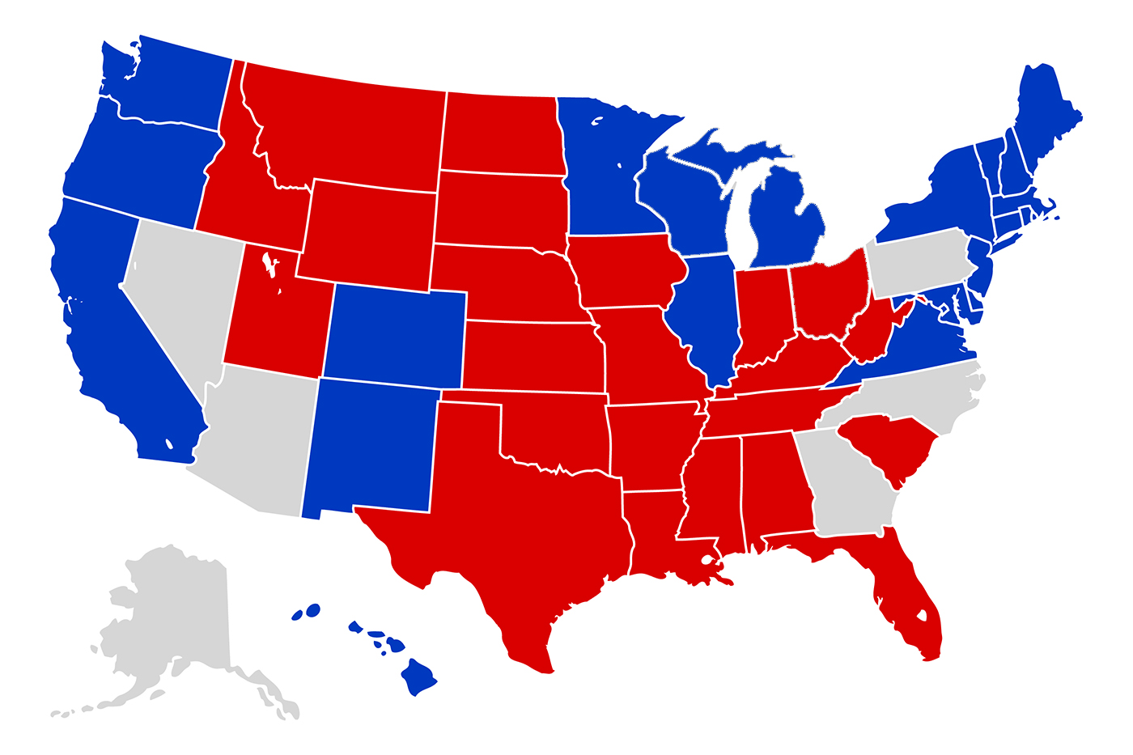

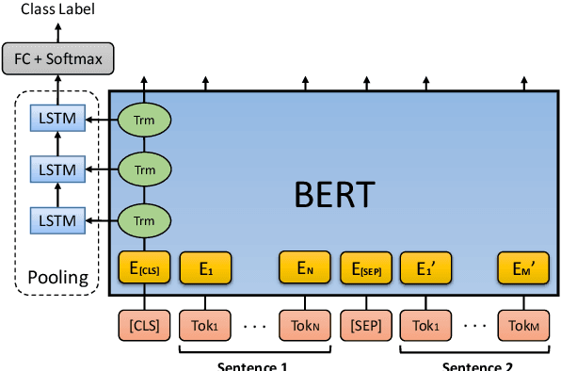

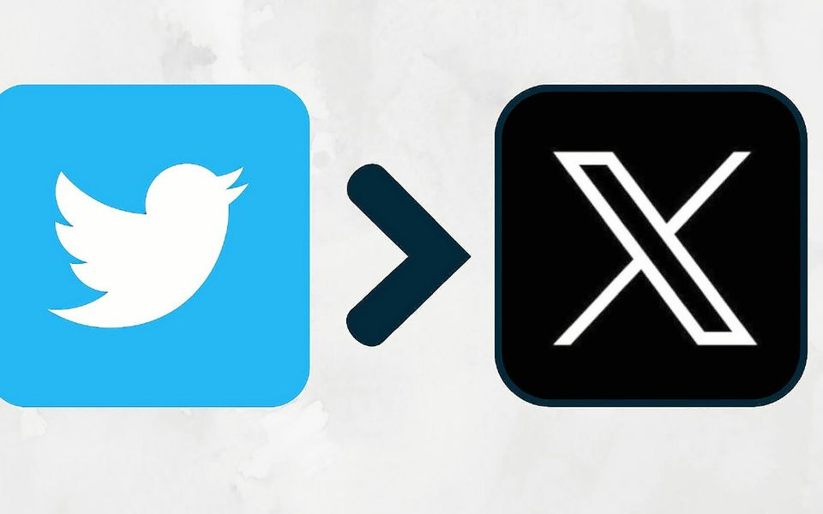
US ELECTIONS 2024 RESULTS PREDICTION. HOW ?
By : Adnane El Amrani
Supervised by: Dr.Mourhir Asmaa
Notes:
The paper "Knowledge Enhanced Masked Language Model for Stance Detection" by Kornraphop Kawintiranon and Lisa Singh presents a novel approach to improve stance detection in tweets related to political entities, specifically in the context of the 2020 US Presidential election.
Methdology:
Problem Definition: They define stance detection as classifying text to determine if the position is in support, opposition, or neutral towards a target, such as a political candidate.
Challenges of Twitter Data: The authors acknowledge the unique challenges posed by Twitter's data, including the brevity of tweets, the rapid evolution of language and terminology, and the deviation from standard prose.
Fine-Tuning Language Models: They discuss how fine-tuning pre-trained models with large-scale in-domain data has become the state-of-the-art approach for many NLP tasks, including stance detection.
Weighted Log-Odds-Ratio for Word Identification: Unlike random token masking in traditional BERT pre-training, the authors propose using weighted log-odds-ratio to identify and focus on words with high stance distinguishability. This helps in better understanding the stance each word represents in the context of political discourse.
Attention Mechanism Focusing on Key Words: By modeling an attention mechanism that concentrates on stance-significant words, the language model becomes more attuned to stance-related nuances in the text.
Performance Superiority: They show that their proposed approach outperforms the state-of-the-art in stance detection for Twitter data about the 2020 US Presidential election.
Methodology:
They collect and preprocess a dataset of tweets related to the election.
Significant stance words are identified using knowledge mining techniques.
An enhanced Masked Language Model (MLM) is created by masking these significant tokens.
The model is fine-tuned on the stance detection task using a labeled dataset.
Their novel KE-MLM approach integrates these significant tokens during the fine-tuning process for BERT.
Empirical Evaluation: They evaluate their model using a dataset containing labeled tweets about the election, showing improvements in detection accuracy.
Contributions and Resources: The authors release their labeled stance dataset to aid further research and highlight their contributions, including the log-odds-ratio technique for identifying stance words and the novel fine-tuning method.
Conclusions and Future Work: They conclude that their approach can serve as a new standard for stance detection. They also suggest future research directions, such as adjusting the significance level of tokens during fine-tuning and exploring the application of their method to other NLP tasks.
How BERT Works:
Pre-training on Large Text Corpora: BERT is initially pre-trained on a large corpus of text. This pre-training involves learning the relationships between words. BERT's pre-training consists of two main tasks: Masked Language Modeling (MLM) and Next Sentence Prediction (NSP).
Masked Language Modeling (MLM): In this task, BERT randomly masks some percentage of the input tokens and the model then attempts to predict the original value of the masked words, based on the context provided by the other, non-masked, words in the sequence.
Next Sentence Prediction (NSP): This task involves understanding the relationship between two sentences. BERT is given pairs of sentences and learns to predict if the second sentence is the subsequent sentence in the original document.
Bidirectional Context: BERT's architecture allows it to understand the context of a word based on all of its surroundings (left and right of the word).
Transformer Architecture: BERT is based on the Transformer architecture, which relies on attention mechanisms to provide context for any word in a sentence.
Modifications for Stance Detection:
In their paper, Kawintiranon and Singh propose an enhancement to the pre-training process of BERT for stance detection:
Knowledge Enhancement: They suggest integrating knowledge about significant stance-relevant tokens into the pre-training process. This is achieved by identifying words that have a high stance distinguishability using a weighted log-odds-ratio method.
Focused Attention Mechanism: Instead of using random token masking, the authors propose a model that uses an attention mechanism focusing on these significant words during the MLM process.
Fine-Tuning with Stance Data: After the modified pre-training, BERT is fine-tuned on labeled data specific to stance detection. This fine-tuning process adjusts the parameters of the model so that it becomes better at identifying the stance (support, opposition, or neutral) towards the given target.
Performance Improvement: The approach outlined in the paper shows that this method of focusing on stance-relevant vocabulary during learning improves stance detection on Twitter data.

Slide 2
Outline
Introduction​
Context
Model Card Presentation
How the BERT Model works ? (Example of 2020 US Elections)
Proposed pipeline
Meeting Minimum Requirements
Conclusion
Notes:
Here are the links:
https://huggingface.co/vinai/bertweet-base
https://paperswithcode.com/search?q=author%3AKornraphop+Kawintiranon&order_by=stars (first paper in this link)
https://huggingface.co/kornosk
https://www.mdpi.com/1424-8220/22/11/4157

Slide 3

Introduction
Sentiment Analysis is the process of ‘computationally’ determining whether a piece of writing is positive, negative or neutral. It’s also known as opinion mining, deriving the opinion or attitude of a speaker.
Election prediction using sentiment analysis is a new rapidly growing field that utilizes natural language processing and machine learning techniques to predict the outcome of political elections by analyzing the sentiment of online Tweets (conversations in general)
Sentiment analysis, or opinion mining, involves using text analysis to identify and extract subjective information from text data sources.
The USA election campaigns in 2008, 2012, and 2016 demonstrated the ground-breaking effect of Social Media on the general population of the United States.
Obama was the first politician to effectively utilize Social Media as a campaign strategy
Notes:
Stance detection and sentiment analysis are both tasks within the field of natural language processing (NLP) and computational linguistics, but they focus on different aspects of textual interpretation.
Sentiment Analysis:
The goal of sentiment analysis is to determine the emotional tone behind a series of words, used to gain an understanding of the attitudes, opinions, and emotions expressed within an online mention.
It is primarily concerned with identifying the polarity of text content - whether the expressed opinion in the text is positive, negative, or neutral.
Sentiment analysis is often applied to social media posts, reviews, and any other places where people express their opinions to understand consumer sentiment, public opinion, etc.
Techniques include machine learning models such as Naive Bayes, Logistic Regression, SVM, and deep learning approaches like LSTM, as well as lexicon-based methods that assign sentiment scores to words.
Stance Detection:
Stance detection is about determining the writer's position (favor, against, neutral) on a specific topic or claim, regardless of the emotional content.
Unlike sentiment analysis, which focuses on the affective aspect, stance detection identifies the alignment of the author's point of view with a particular standpoint.
It is a crucial task in understanding public opinion on controversial issues, gauging support for political candidates or policies, and analyzing debates.
Stance detection often requires understanding the context beyond the text itself, as a positive sentiment does not necessarily mean support for a certain stance, and vice versa.
The challenge in stance detection lies in the subtleties of language, as the same expression can be used sarcastically or earnestly, and the stance might not be explicitly stated but implied.
Both tasks are important for different reasons and use cases:
Sentiment analysis is widely used in brand monitoring, market research, and customer service, as it provides insights into how people feel about products, services, or topics.
Stance detection is particularly useful in political science, public policy, and argument mining, where understanding the position someone takes is more critical than the emotional tone of their language.
Advanced NLP systems may perform both tasks together to gain a comprehensive understanding of text data, using sentiment analysis to capture the emotional tone and stance detection to understand the position towards the subject matter.

Slide 4
US Political system main characteristics
Federal System: The U.S. operates under a federal system of government, where power is divided between the national (federal) government and the state governments. This system allows for a balance of power, with certain powers reserved for the federal government (like defense and foreign affairs), and others for the states (like education and law enforcement).
Presidential System: Unlike parliamentary systems, the U.S. has a presidential system where the executive branch is separate from the legislative branch.
The President of the United States is both the head of state and the head of government, elected independently of the legislature .
Two-Party System: While there are multiple political parties in the U.S., it is predominantly a two-party system, with the Democratic Party and the Republican Party being the major parties. These parties have dominated American politics for most of the country's history.

Slide 5
POLITICAL Assumptions
Social Media as a Representative Sample: This assumes that the opinions expressed on Twitter are representative of the broader electorate's views. However, Twitter users might not accurately represent the entire voting population due to various factors like age, political engagement, internet access, and social media usage patterns.
Accuracy of Sentiment Analysis Tools: BERT, as an advanced NLP model, is assumed to accurately capture and interpret the sentiment of tweets. This includes understanding context, sarcasm, and subtle nuances in language. However, the complexity of human language and the brevity of tweets can pose challenges.
Political Polarity Reflects Voting Behavior: This assumption posits that the polarity (positive or negative sentiment) towards a political candidate or party on social media correlates directly with voting behavior. However, voter behavior is influenced by a multitude of factors beyond social media sentiment, including economic conditions, political campaigns, and personal beliefs.

Slide 6
POLITICAL Assumptions
Stability of Political Opinions: The approach assumes that the sentiments expressed on Twitter are stable and not subject to rapid change. In reality, political opinions can be highly volatile, especially in response to current events or new information.
Impact of Echo Chambers and Bots: Twitter can contain echo chambers where users predominantly interact with like-minded individuals, potentially skewing sentiment analysis. Additionally, the presence of bots and artificial accounts can distort the perceived sentiment toward a candidate or issue.
Neutral Tweets and Non-Participation: Not all tweets are clearly positive or negative. Neutral or ambiguous tweets can be challenging to interpret and might be ignored or misclassified. Moreover, not all potential voters express their political opinions on Twitter.
Notes:
In the United States, political campaigns can be financed through a variety of legal sources, according to federal laws regulated by the Federal Election Commission (FEC). Here are the primary legal sources of campaign finance:
Individual Contributions: Individuals are allowed to donate directly to political candidates, parties, and political action committees (PACs). There are limits to how much an individual can contribute to each candidate, national party committee, and other political committees each election cycle.
Political Action Committees (PACs): PACs can contribute to campaigns, subject to limits. There are several types of PACs, including Connected PACs (established by businesses, labor unions, trade groups, or health organizations), Nonconnected PACs (which are not sponsored by or connected to any of the aforementioned entities), and Leadership PACs (started by politicians to help fund other candidates' campaigns).
Super PACs: Officially known as "independent-expenditure only committees," Super PACs may not contribute directly to candidate campaigns or parties, but they can spend unlimited amounts on political messaging independently of the campaigns. They must, however, report their donors to the FEC.
Political Parties: Political parties can contribute to campaigns, but they are subject to contribution limits and other regulations. They can also spend money on coordinated expenditures with candidates.
Self-funding: Candidates can use their own personal funds to finance their campaigns without any limit. This is considered a form of speech under the First Amendment and is protected from regulation.
Small-Donor Contributions: Small donations from a large number of individuals, often collected online, have become a significant source of campaign financing, particularly for candidates who prioritize grassroots fundraising.
Federal Funding: Presidential candidates can qualify for public funding for their primary and general election campaigns, but accepting public funding comes with spending limits. Many candidates opt out of public funding to avoid these limits.
501(c) Organizations: These nonprofit organizations can engage in varying degrees of political activity, depending on their specific tax status. 501(c)(3) organizations, for example, are prohibited from engaging in any political activity, while 501(c)(4) organizations can engage in some political activities as long as it is not their primary activity.
527 Organizations: These tax-exempt groups can raise unlimited funds to support political activities like voter mobilization and issue advocacy, but they cannot directly advocate for the election or defeat of a federal candidate.
Under current U.S. federal law, corporations cannot donate directly to political candidates or their campaigns. However, corporations can participate in the political process in several other ways:
Political Action Committees (PACs): Corporations can establish PACs to collect contributions from a restricted class, generally consisting of managers and shareholders, and then contribute those funds to candidates or political parties within the federal contribution limits.
Super PACs: Corporations can contribute an unlimited amount of money to Super PACs, which are independent-expenditure only committees. Super PACs can't contribute directly to candidates or coordinate with their campaigns, but they can spend money on political advertising and other activities that advocate for the election or defeat of a candidate.
Independent Expenditures: Corporations can spend money independently of campaigns to advocate for or against candidates through various forms of media. This was largely enabled by the Supreme Court's decision in Citizens United v. FEC, which ruled that government restrictions on independent political expenditures by corporations and unions are unconstitutional under the First Amendment.
Nonprofit Organizations: Corporations can donate to certain types of nonprofit organizations, such as 501(c)(4) "social welfare" groups, which can engage in political activities, provided that these activities are not their primary function. These groups are not required to disclose their donors.
Trade Associations and Chambers of Commerce: Corporations can also contribute to trade associations and chambers of commerce that engage in political activities on behalf of their members.
Lobbying: While not a direct form of campaign financing, corporations can spend money on lobbying to influence legislation and public policy.
It's important to note that while corporations have these avenues to influence politics, they are subject to regulations and reporting requirements. The rules can also vary by state, with some states having different regulations for corporate contributions to state and local candidates. Transparency and disclosure requirements are intended to make corporate political activities known to the public and shareholders.

Slide 7
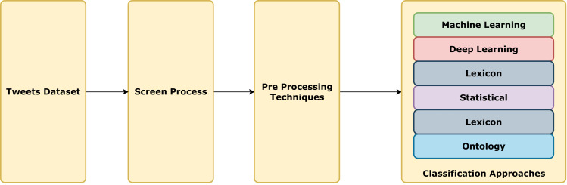
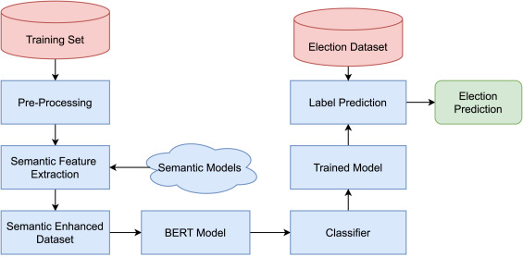
Notes:
Tweets Dataset: This is the initial collection of tweets that will be analyzed. The dataset typically consists of a large number of tweets that may have been collected over a certain period or related to specific topics or hashtags.
Screen Process: This step involves filtering the tweets dataset to remove irrelevant data. This might include removing non-textual elements, filtering out tweets not in the desired language, or eliminating spam and bot-generated content.
Pre-Processing Techniques: In this stage, the tweets are prepared for analysis. Pre-processing can include a variety of tasks such as:
Removing stop words (common words that do not add much meaning to a sentence)
Lowercasing all the text
Removing punctuation and special characters
Stemming or lemmatization (reducing words to their base or root form)
Handling emojis and slangs
Correcting misspellings
Pre-processing techniques are those technique(s) applied to the raw dataset to avail formatted, error-free dataset. The relevant algorithm(s) then use this processed dataset to achieve maximum accuracy with minimal deterioration in their otherwise smooth performance.
Stemming Stemming is a technique that refers to all variations of a word to its root word, such as ‘warming’, ‘warmest’, ‘warmed,’ and ‘warmer’, which will be stemmed from the word ‘warm.’ This method reduces the time and memory space by removing suffixes that have exactly matching meanings and stem. For sentiment analysis on the text data, every word should be represented by the stem rather than the word mentioned in the text (Al-Khafaji & Habeeb, 2017).
Stop word removal Stop words are the words that are useless within the raw dataset. These words do not provide helpful information in the data set, so they must be removed to save computation time, storage, and space and improve the algorithm’s efficiency. Most stop words are pronouns and helping verbs like is, of, the, to, and/or (Al-Khafaji & Habeeb, 2017).
Tokenization Tokenization is a method to split the words within a sentence. Each split character, word, or symbol is called a token. It is an appropriate method in text analysis (Al-Khafaji & Habeeb, 2017). Like, [the president has worked well] will be tokenized into [the, president, has, worked, well] (Wongkar & Angdresey, 2019). These tokens help identify a content’s intent which helps in sentiment or text analysis.
Classification Approaches: After pre-processing, various classification approaches can be applied to determine the sentiment of the tweets. These include:
Machine Learning: Using algorithms like Naive Bayes, Support Vector Machines (SVM), or Random Forests to classify sentiment based on features extracted from the text.
Deep Learning: Leveraging neural networks, particularly Recurrent Neural Networks (RNNs) or Convolutional Neural Networks (CNNs), to capture the sequential nature of language for sentiment classification.
Lexicon-Based: Utilizing a predefined dictionary or lexicon of words that have been assigned positive or negative sentiment scores.
Statistical: Applying statistical methods to identify patterns or correlations between words in the text and their associated sentiments.
Ontology-Based: Using an ontology, a structured framework of knowledge, to understand the context and relationships between words in the tweets.

Slide 8
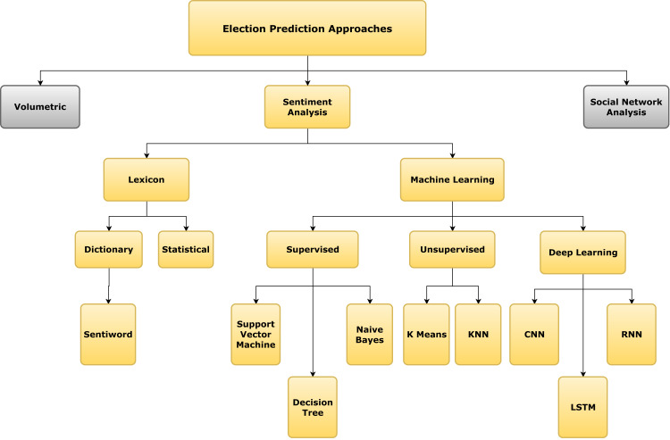
Notes:
In the context of this chart, BERT would fall under the "Deep Learning" category within "Sentiment Analysis". It would be considered alongside other neural network-based approaches like CNN (Convolutional Neural Network), RNN (Recurrent Neural Network), and LSTM (Long Short-Term Memory). BERT could be used for sentiment analysis and potentially for social network analysis when it comes to understanding the context of communications within the network.
Volumetric Analysis: This approach predicts election outcomes based on the volume of mentions or the amount of activity related to a candidate or party. The underlying assumption is that more mentions correlate with higher popularity or engagement, which might translate to electoral success.
Sentiment Analysis: This is the process of computationally determining whether a piece of writing is positive, negative, or neutral. It's often used to gauge public opinion from text data on social media, news outlets, and other platforms.
Lexicon-Based Methods: These rely on a predefined list of words (lexicon) that have been assigned sentiment scores.
Dictionary: A simple form of lexicon where words are tagged as positive or negative.
Statistical: This approach goes further by using statistical techniques to assign sentiment scores based on word co-occurrence frequencies or other statistical measures.
Sentiword: This likely refers to SentiWordNet, a lexical resource for opinion mining that assigns to each synset of WordNet three sentiment scores: positivity, negativity, and objectivity.
Machine Learning Methods: These involve training algorithms to learn from data and make predictions or decisions based on that data.
Supervised Learning: With labeled datasets, these methods learn to predict the sentiment of new texts.
Support Vector Machine (SVM): A classification algorithm that finds the hyperplane that best separates data into classes.
Naive Bayes: A probabilistic classifier based on applying Bayes' theorem with strong (naïve) independence assumptions between the features.
Decision Tree: A decision support tool that uses a tree-like model of decisions and their possible consequences.
Unsupervised Learning: These methods look for patterns within the data without pre-labeled responses.
K-Means: A clustering algorithm that partitions n observations into k clusters in which each observation belongs to the cluster with the nearest mean.
KNN (k-Nearest Neighbors): A method used for classification and regression that operates on the principle that similar things exist in close proximity.
Deep Learning Methods: These utilize neural networks with multiple layers to learn data representations.
Convolutional Neural Network (CNN): Primarily used in image recognition, CNNs can also be used for sentence classification tasks in NLP.
Recurrent Neural Network (RNN): Suitable for sequence prediction problems because they can use their internal state (memory) to process sequences of inputs.
LSTM (Long Short-Term Memory): A special kind of RNN that is capable of learning long-term dependencies, particularly effective for tasks involving sequences, such as time series analysis or natural language processing.
Social Network Analysis: This refers to the use of network and graph theories to understand social structures. In election prediction, it could involve analyzing how information spreads through networks and the influence of various actors within a social network.

Slide 9
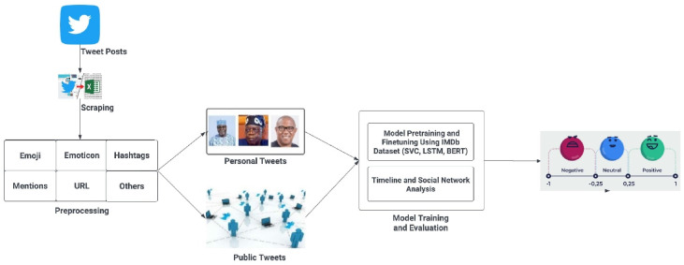
Why bERT specifically?
According to : https://ncbi.nlm.nih.gov/pmc/articles/PMC10495957/
This deep learning approach was implemented to forecast US presidential elections 2020 in Singh et al. (2021):
Three machine learning algorithms (SVM, NB, and TextBlob) and one deep learning algorithm (BERT) were trained and evaluated.
As a result, the BERT algorithm attained the highest prediction rate of 94%.
Notes:
Contextual Understanding: BERT is designed to understand the context of each word in a sentence, rather than just analyzing words in isolation. This allows BERT to capture nuances in language that other models might miss, which is particularly important for the often ambiguous and nuanced language used in political tweets.
Bidirectional Training: BERT is trained bidirectionally, meaning it learns information from both the left and the right side of a token's context during the training phase. This differs from traditional models that typically process text in a single direction (left-to-right or right-to-left), which can limit their ability to understand the full context of the text.
Transfer Learning: BERT is a pre-trained model that has already learned language patterns from a large corpus of text before it's fine-tuned for a specific task like sentiment analysis. This pre-training on diverse language data provides a solid foundation for understanding language, which can then be adapted to the specifics of political sentiment analysis with relatively little additional training data.
Deep Learning Capabilities: As a deep learning model, BERT has a complex architecture with a large number of layers (transformer blocks), which allows it to model high-level abstract patterns in data. This complexity can capture intricate relationships in the data that simpler models may not be able to.
Fine-Tuning Efficiency: With BERT, fine-tuning for a specific task (such as sentiment analysis) can be done with fewer data and less computational resources compared to training a model from scratch, while still achieving high accuracy.
Handling of Sequences: BERT treats the input data as sequences, which helps it to understand and predict sentiments in longer strings of text, like sentences or paragraphs, which are common in tweets.
Robustness to Noisy Data: Social media data is often noisy, with misspellings, slang, and inconsistent use of language. BERT's robustness to such noise, thanks to its pre-training on a diverse set of data sources, can help it perform better than models which might be more sensitive to such inconsistencies.
State-of-the-Art Results: At the time of its introduction, BERT achieved state-of-the-art results on a number of natural language processing tasks, which has led to its widespread adoption for tasks where understanding context and complex language patterns is important.

Slide 10
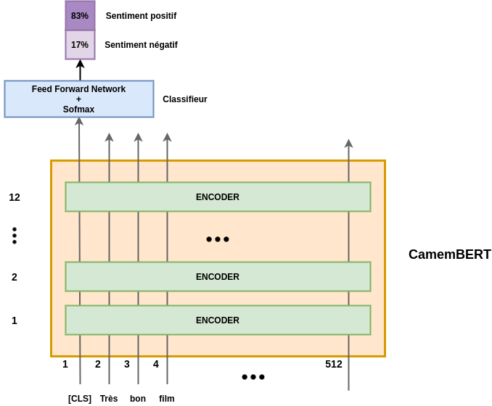
Notes:
CamemBERT is a variant of BERT pre-trained on French language data. Here is how this model or architecture works:
Input Representation:
The input text ("Très bon film" meaning "Very good movie") is tokenized into subword tokens that BERT can understand. Each token is then converted into a vector using embeddings.
The special [CLS] token is added at the beginning of the sequence. This token is used for classification tasks and will gather aggregate representation for the whole sequence.
BERT Encoders:
The input embeddings pass through multiple layers of encoders (in this case, 12 layers, indicating it's likely a base model of CamemBERT).
Each encoder layer consists of multiple self-attention heads and a feed-forward network. Self-attention allows the model to weigh the importance of different words in the sentence relative to each other.
The encoders process the input in parallel, updating the embeddings at each layer to incorporate more context.
Output from the Last Encoder:
The final layer's encoder output corresponding to the [CLS] token is used to represent the entire input sequence. It contains the context-aware features that have been learned across all layers.
Classification Head:
The [CLS] token's output vector is fed into a feed-forward neural network with a softmax layer on top (often called the classifier head).
The feed-forward network transforms the [CLS] embedding into a space that is suitable for classification.
The softmax function then outputs a probability distribution over the possible classes. In this case, it seems to be a binary classification task for sentiment analysis, with the probabilities summing to 100%.
Sentiment Analysis Output:
The model predicts the sentiment of the input text, outputting a probability for positive sentiment ("Sentiment positif") and negative sentiment ("Sentiment négatif").
In the given example, the model predicts an 83% probability that the sentiment of the text is positive, and a 17% probability that it is negative, indicating it classifies the text as having a positive sentiment.
The architecture presented in the image shows how a transformer-based model like CamemBERT can be fine-tuned for specific tasks such as sentiment analysis, utilizing its pre-trained context-aware embeddings for improved performance on tasks that require an understanding of the nuances in language.

Slide 11
Proposed pipeline
1- Data Collection, Pre-processing and Update
2- Model Re-training and Fine-tuning
3- Sentiment Analysis Adaptation
4- Incorporating New Political Context
5- Feature Extraction and contextual understanding
6- Enhanced Performance Metrics
7- Stakeholder Feedback Integration
8- Testing and Validation
9- Deployment and Monitoring and Maintenance
Notes:
Data Collection, Pre-processing and Update:
Collecting a comprehensive dataset of relevant text data, which could include tweets, political speeches, debates, and news articles from the period leading up to the 2024 elections.
Cleaning the data by removing noise such as irrelevant posts, spam, and any non-textual elements like URLs or user mentions.
Regularly updating the dataset to include the most recent and relevant information as the political climate evolves.
Model Re-training and Fine-tuning:
Using the collected data to re-train the BERT model to adapt it to the language and issues pertinent to the 2024 election.
Fine-tuning the model parameters on a more specific subset of the data, such as tweets regarding key election issues or candidate debates, to improve its predictive accuracy for the election context.
Sentiment Analysis Adaptation:
Adapting the BERT model to recognize the sentiment of text data accurately, which is essential for understanding public opinion on candidates and issues.
This might involve training the model to better understand political jargon, sarcasm, and subtleties specific to political discourse.
Incorporating New Political Context:
Introducing the model to the specific political context of the 2024 elections, including new political figures, emerging issues, and the shifting allegiances of the public.
This could involve training on data that captures the dynamics of the current political environment and the historical information that could impact the 2024 scenario.
Feature Extraction and Contextual Understanding:
Extracting features from the text data that are most predictive of election outcomes, such as mentions of specific policies or candidates.
Enhancing the model's ability to understand context, which is critical for interpreting the meaning of words and phrases within the complex political discourse.
Enhanced Performance Metrics:
Developing and tracking performance metrics beyond accuracy, such as precision, recall, F1-score, and AUC-ROC, to better evaluate the model's predictive performance.
Implementing metrics that can capture the nuances of sentiment analysis, like the intensity of sentiment or the shift in public opinion over time.
Stakeholder Feedback Integration:
Gathering feedback from political analysts, campaign workers, and perhaps even the public to identify any biases or blind spots in the model.
Iteratively improving the model based on this feedback to ensure it aligns with real-world election dynamics and stakeholder expectations.
Testing and Validation:
Rigorously testing the model with new, unseen data to validate its performance.
Using cross-validation and other statistical methods to ensure that the model is robust and not overfitted to the training data.
Deployment and Monitoring and Maintenance:
Deploying the model into a production environment where it can process new data and provide ongoing predictions about the election outcome.
Continuously monitoring the model's performance and maintaining it by retraining it with new data, adjusting parameters, and refining features as necessary to account for changes in the political landscape.

Slide 12
BUSINESS CASE DESC.
The objective is to develop an ML model to predict the outcome of the 2024 U.S. presidential election based on sentiment analysis of publicly available text data.
The model would help political analysts, campaign managers, news agencies, and bettors understand public sentiment and potential voting patterns.
Insights derived from the model could inform campaign strategies, media coverage, and financial markets.
Notes:
This milestone outlines the initial phase in developing a machine learning system to analyze sentiments related to the US Elections 2024, transitioning from the 2020 elections analysis model.
This model card represents a comprehensive guide for an AI model designed for digital transformation and machine learning projects, focusing on sentiment analysis of tweets related to the US Elections 2024.
The model is specifically tailored for application in the United States and not suitable for regions like Morocco due to differences in linguistic, cultural, constitutional and political contexts.
The transition from analyzing the 2020 US Elections to the 2024 Elections using machine learning involves several key steps and considerations to ensure the relevance and effectiveness of the AI model. This model card outlines a machine learning system for analyzing sentiment related to the US Elections 2024, similar to what was done for the 2020 elections. Both utilize the BERT language model to understand sentiments from Twitter data, which indicates a methodological alignment.
BERT (Bidirectional Encoder Representations from Transformers) is a groundbreaking model in the field of Natural Language Processing (NLP) developed by Google. The innovative aspect of BERT is its deep bidirectionality, which allows the model to understand the context of a word based on all of its surroundings (left and right of the word).

Slide 13
BUSINESS VALUE
This AI model is positioned as a cutting-edge tool for political sentiment analysis, offering precise, real-time insights for strategic decision-making.
ML can process vast amounts of data more efficiently than manual analysis, providing real-time insights into public opinion.
By predicting election outcomes, stakeholders can make data-driven decisions, potentially gaining a competitive advantage.
The ability to understand and react to voter sentiment quickly can be crucial for political campaigns to allocate resources effectively.
The goal is to leverage ML for predicting election outcomes, enabling businesses to make informed investment decisions in advertising and campaign strategies.
Maximizing ROI: By improving the accuracy of sentiment analysis, the model aids in minimizing losses and risks associated with political investments, optimizing tax strategies, and maximizing ROI.

Slide 14
BUSINESS VALUE
Mapping Accuracy to Investment: The model's accuracy in sentiment analysis directly correlates with the effectiveness of investment decisions in political campaigns.
Strategic Decision-Making: Provides political strategists and campaigners with insights into public opinion trends, enabling data-driven decision-making.
Targeted Campaigning: Helps in tailoring political messages and advertisements based on public sentiment.
Predictive Analysis: Forecasts election outcomes, aiding in investment decisions related to campaign financing and media planning.

Slide 15
Business Impact and R.O.I
Goal: Enhancing the accuracy of election outcome predictions
R.O.I Measurement: Tracking the correlation between model predictions and actual election results, and the impact on campaign R.O.I.
Risk Mitigation: Reducing investment risks and maximizing returns through accurate sentiment analysis.
Accuracy in Sentiment Classification: The primary metric; the model's effectiveness in accurately classifying sentiments in tweets.
Predictive Accuracy: The model's ability to predict election outcomes based on sentiment analysis.
R.O.I Impact: Measuring the impact on campaign strategies, including increased engagement, voter turnout, and effective media spending.
User Adoption Rate: The rate at which political analysts and campaign strategists adopt and integrate the tool into their workflows.
Optimization of the cost of Political Advertisement

Slide 16
Project Scope and Objective, Project Name:
• AI-2024-US-Election-Sentiment-Analyzer Goal: Adapt and enhance the existing 2020 election sentiment analysis model for the 2024 US Elections.
• Model Description Model Name: AI-2024-US-Election-Sentiment-Analyzer
• Model Type: Sentiment Analysis using pre-trained BERT.
• Primary Use: Analysis of public sentiment in tweets related to US Elections 2024
• Language: English
• Region of Application: United States (Not applicable for Morocco)
• Architecture: Based on BERT (Bidirectional Encoder Representations from Transformers)
• Training Dataset: Over 10 million English tweets regarding US political discussions, specifically filtered for US Elections 2024 topics.
• Target Audience: Political analysts, campaign strategists, digital marketers, and researchers
• Use Cases: Predicting election outcomes, analyzing public opinion trends, enhancing targeted political campaigning.

Slide 17
DATA REQUIREMENTS
A large and diverse dataset of text data, including social media posts, news articles, and transcripts of political speeches and debates.
The data should cover a wide range of political topics, demographics, and geographical locations to ensure representativeness.
Data should be annotated with reliable sentiment labels, either manually or through a semi-automated process with human oversight.
Access to historical election data, polling results, and demographic information for model training and contextual understanding.

Slide 18
Metrics for Business Goal Evaluation
Accuracy of the model in predicting election outcomes compared to actual results.
Precision and recall in classifying sentiments towards specific candidates or issues.
Timeliness of insights, as political campaigns require rapid response to changing public opinions.
Robustness of the model against shifts in political discourse and the introduction of new topics or candidates.
Accuracy of Stance Detection, Organization Satisfaction
Improvement Over Baselines: The degree to which the new model (KE-MLM) outperforms existing models and baselines could be a business metric, indicating the value added by the new approach.

Slide 19
Baselines:
Historical accuracy of traditional polls and expert analyses in predicting election outcomes.
Performance of standard NLP models on sentiment analysis tasks, such as SVM or Naive Bayes classifiers, before the introduction of BERT.
Benchmarking against other deep learning models like LSTM (Long Short-Term Memory) networks or previous state-of-the-art architectures.

Slide 20
Justification of the model and performance metrics:
The model aims to analyze public sentiment towards political candidates or issues, providing valuable insights for stakeholders in political campaigns, media, and academic research.
Baseline Model Performance: Establishing a baseline using a pre-existing sentiment analysis model, targeting an initial accuracy of 85% or more.
Industry Standard Comparison: Comparing the model’s performance with existing sentiment analysis tools used in political campaigning.
Historical Data Performance: Evaluating the model against past election data to assess predictive reliability.

Slide 21
Performance Metrics
Baseline Accuracy: 85% sentiment classification accuracy or more
Business Impact Metrics: Improved decision-making in political investments, measurable ROI increase in campaign strategies.
Update Frequency: Quarterly retraining with updated datasets
Monitoring Metrics: Accuracy, precision, recall, and real-time performance in sentiment classification
Notes:
Continuous monitoring is essential for maintaining model accuracy.
This involves regular updates to the dataset, algorithm adjustments, and performance tracking against key metrics.

Slide 22
Conclusion & Q&A Session
In conclusion, the project aimed at predicting the outcomes of the U.S. 2024 election using BERT sentiment analysis has demonstrated the innovative intersection of machine learning and political science.
By leveraging state-of-the-art NLP techniques, the project has navigated the complexities of public sentiment as expressed through vast datasets of social media and other textual sources.
The methodology employed a rigorous pipeline that included data collection and preprocessing, model retraining, sentiment analysis adaptation, incorporation of new political contexts, and a focus on feature extraction for deep contextual understanding.

Slide 23
THANK YOU For your attention

